Slide 1

Rudi Hendrickx
Monza, 23/11/2017
Notes:
TRANSPARANTIE – link met vertrouwen en link met broederschap

Slide 2
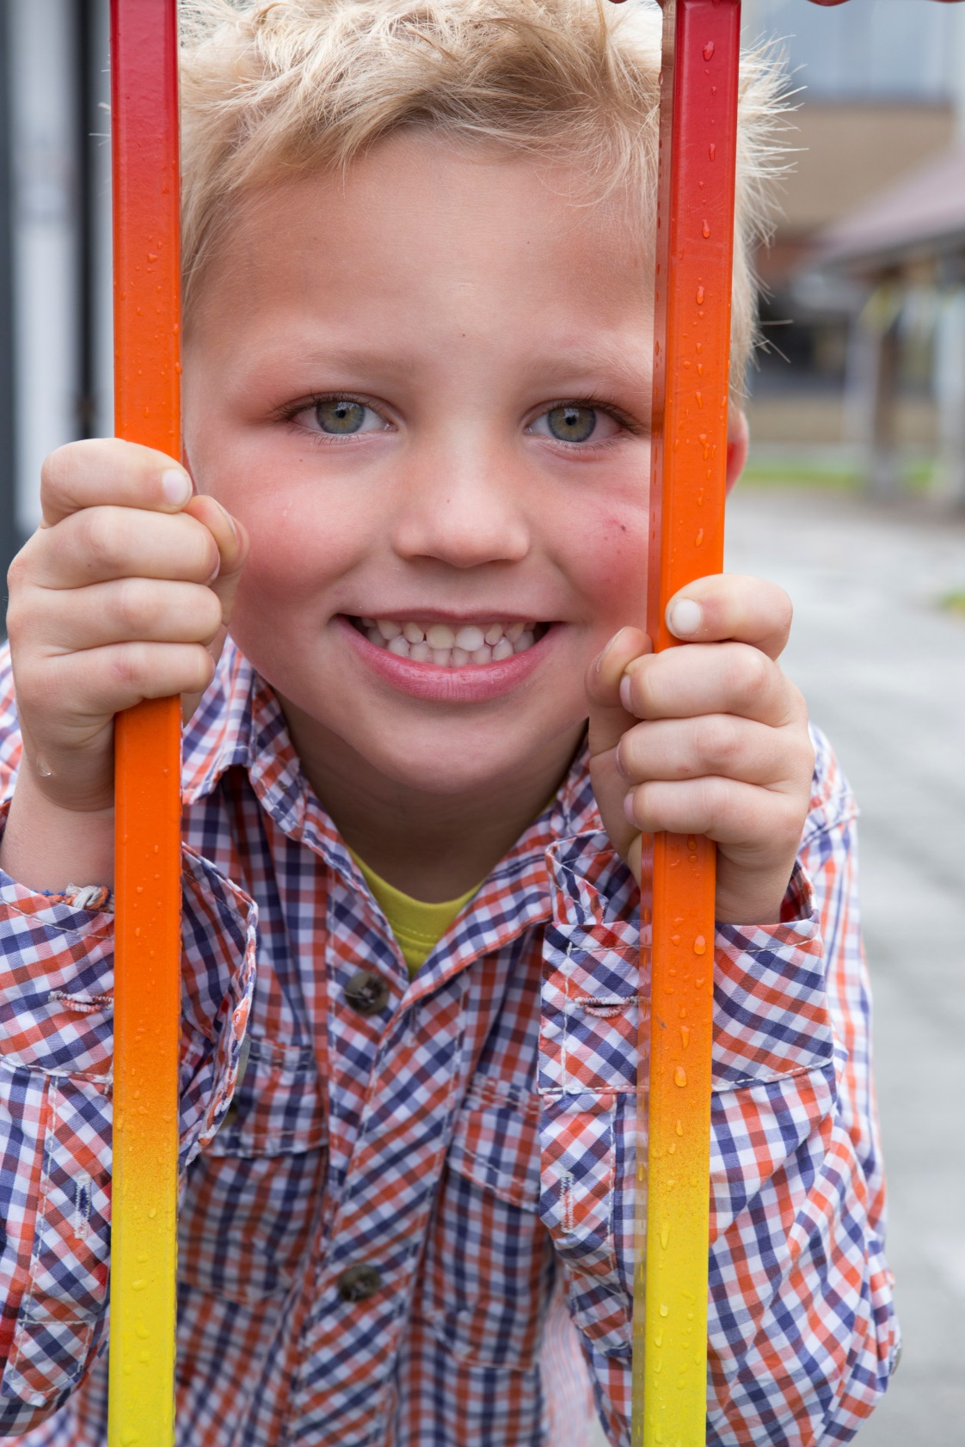
For which organization do
I work ?

Slide 3

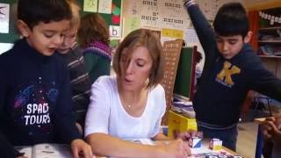
Who are we?
Our pedagogical project
https://www.youtube.com/watch?v=kqf0p7GITa4
GO!
https://www.youtube.com/watch?time_continue=135&v=pe9P-nz4J8Y

Slide 4
Schools in Flanders (Belgium)
Schools have autonomy in school organisation;
Schools are completely free to choose their educational methods and can also develop their own curricula and timetables;
The schools are receiving means (teachers) and money from the Department of Education to organize qualitative good education;
………

Slide 5
School must be established in habitable, safe and clean
buildings

Slide 6
Schools must be sufficiently
equipped and need enough
instructional materials

Slide 7
We are working with attainment targets,
they are minimum goals for all pupils. There are
attainment targets specific to
subject areas (mathematics and Dutch)
and cross-curricular attainment targets
(such as learning how to learn and social
skills).
For the pre-primary there are developmental
objectives, these are skills a school must strive
to develop in pupils, but they need not necessarily
be attained.

Slide 8
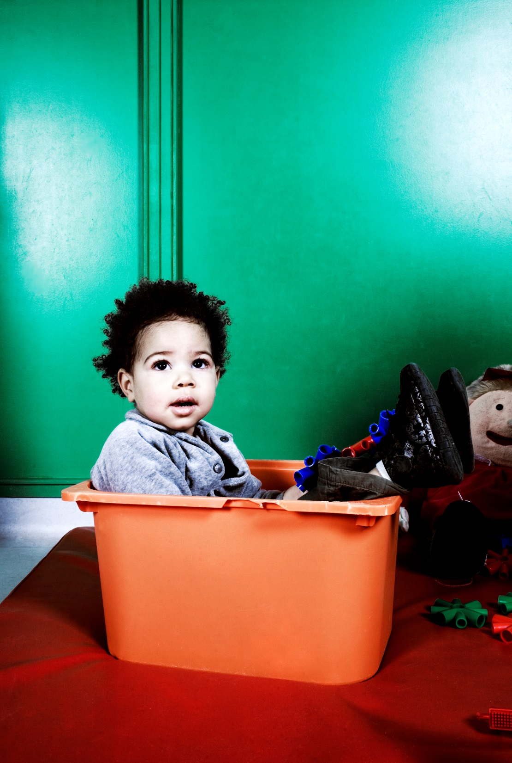
Our pupils

Slide 9
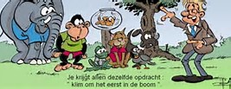

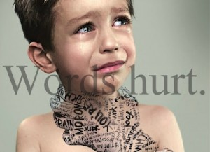
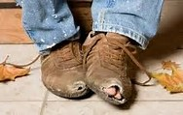
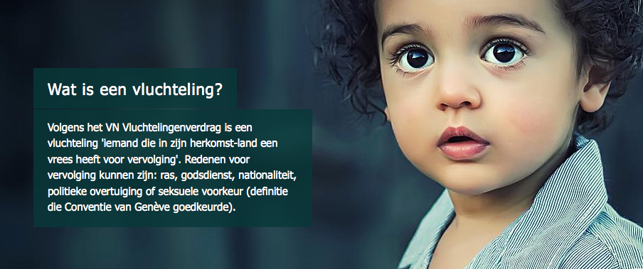
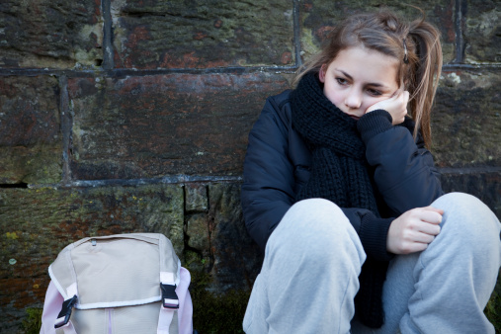

The pupil population changes

Slide 10

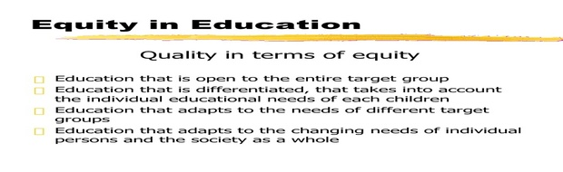

Slide 11
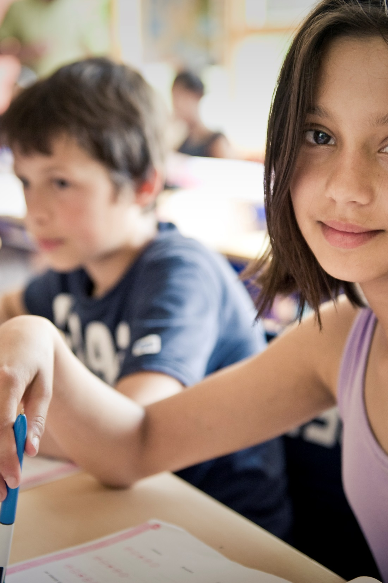
How do we work?

Slide 12
A Flemish school can get
incentives to create equal education opportunities for every child.
The dimension of the extra
means is based on a few child indicators.

Slide 13
Indicators socio-economic status
Opportunities of pupils on a successful school career depend strongly along with the social environment in which they live. Explanations for this include the material situation, the unequal access to cultural goods, the distance between the home culture and the school culture, bridging the gap between the home language and the language of the classroom and the educational support that the parents offer.
This means that ...
We need a set of stable and robust indicators that the coherence of education opportunities for young people and their social environment well.
This is based on social-science and educational research.

Slide 14
Indicators socio-economic status
The MOTHER'S EDUCATION: this indicator stands for the set of knowledge, skills and attitudes. It is an indicator of the extent to which the home culture suits the school culture.
EDUCATION ALLOWANCE: this entry is based on family income and gives an indication of the financial capacity of the family and therefore of the pedagogical (home) comfort: time, study area, purchasing power for goods that promote learning ...
Language: which language is usually spoken at home and is it different from the school language ? This is an indicator of communication and learning capabilities of the student.

Slide 15




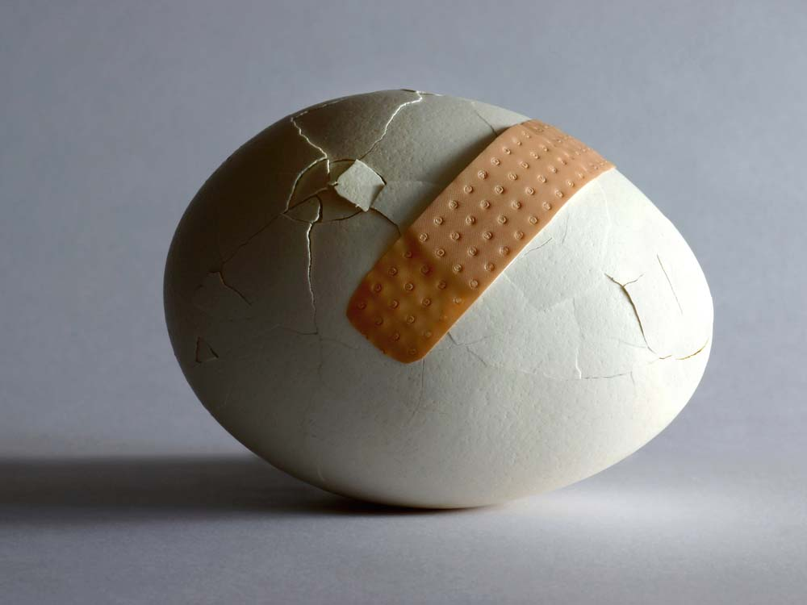
This means ...

Slide 16
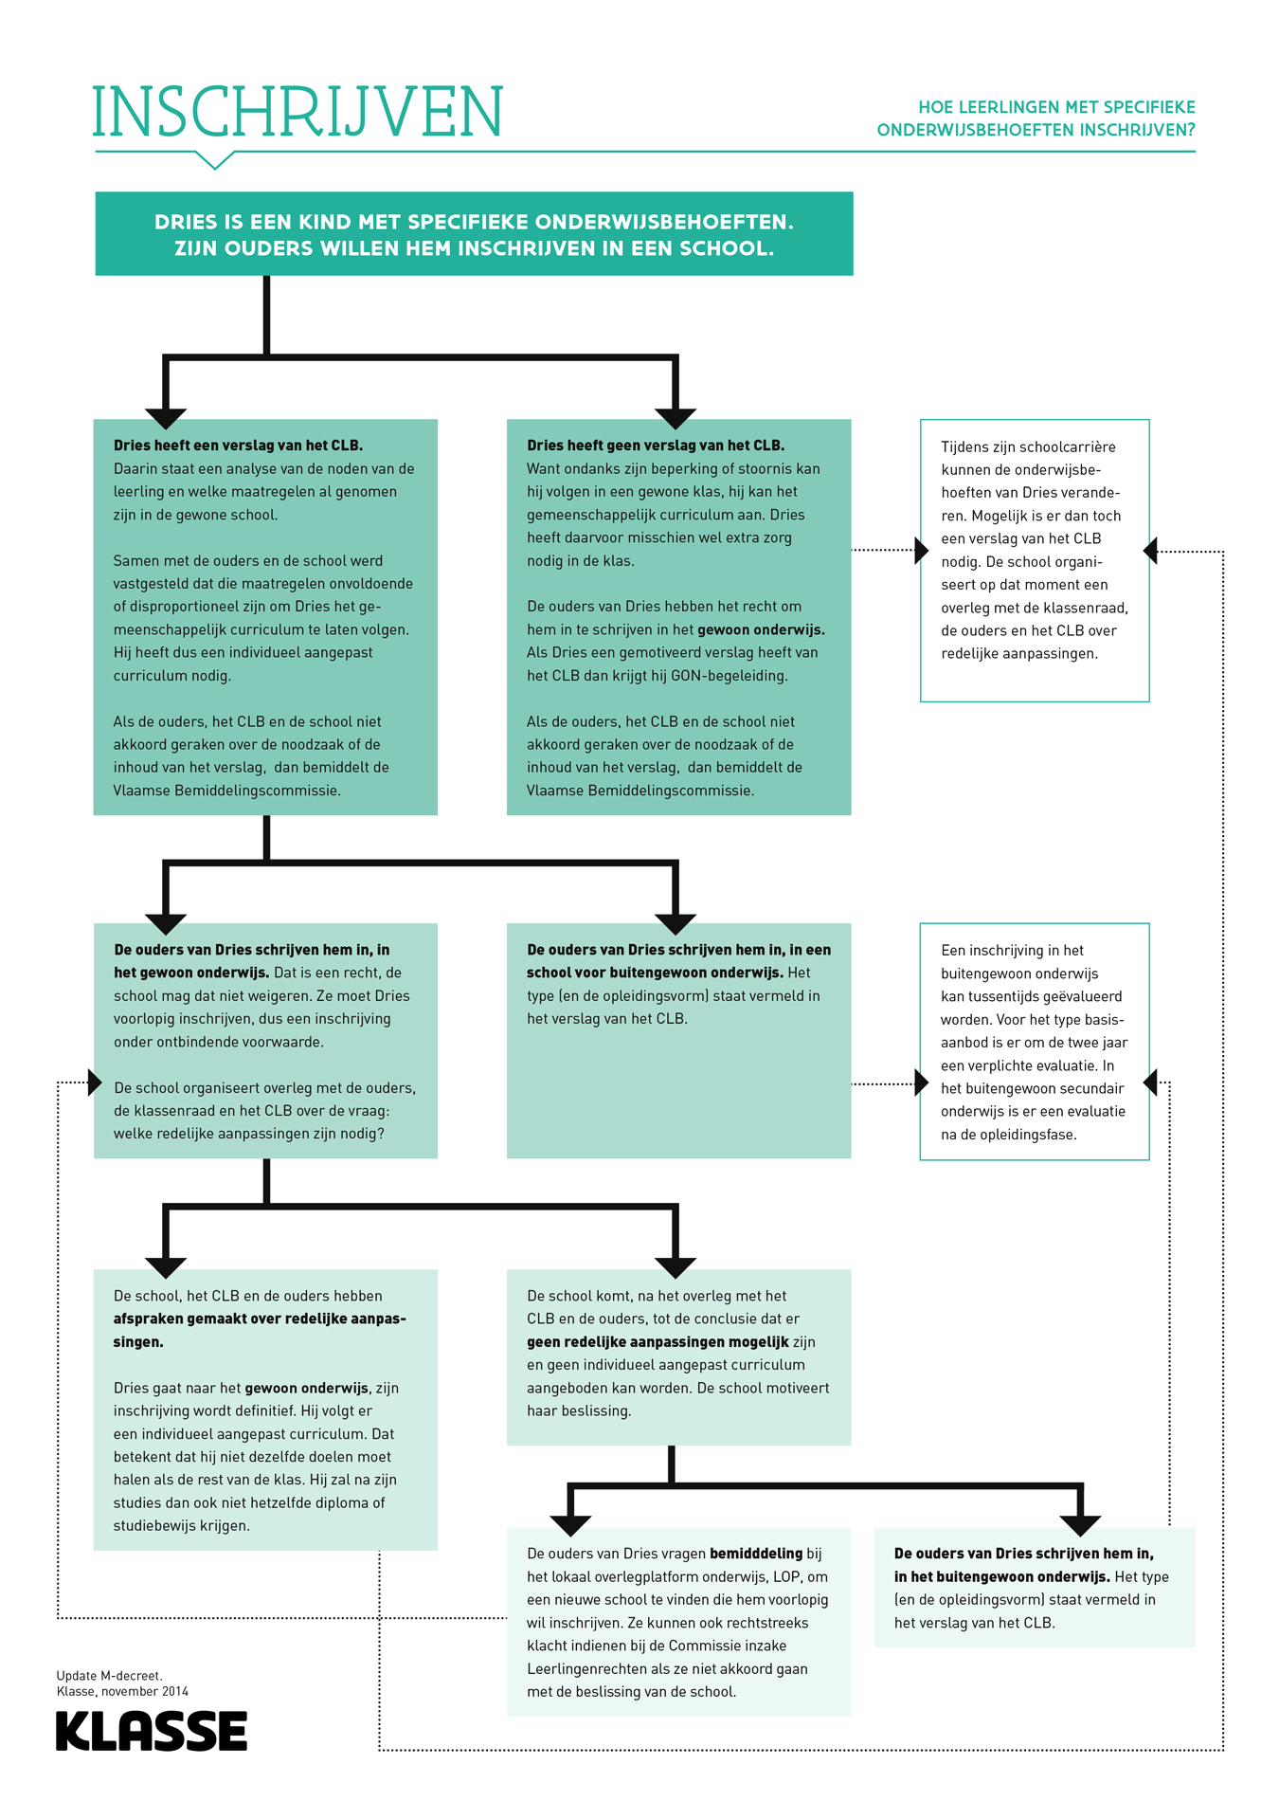
Focus on educational needs

Slide 17
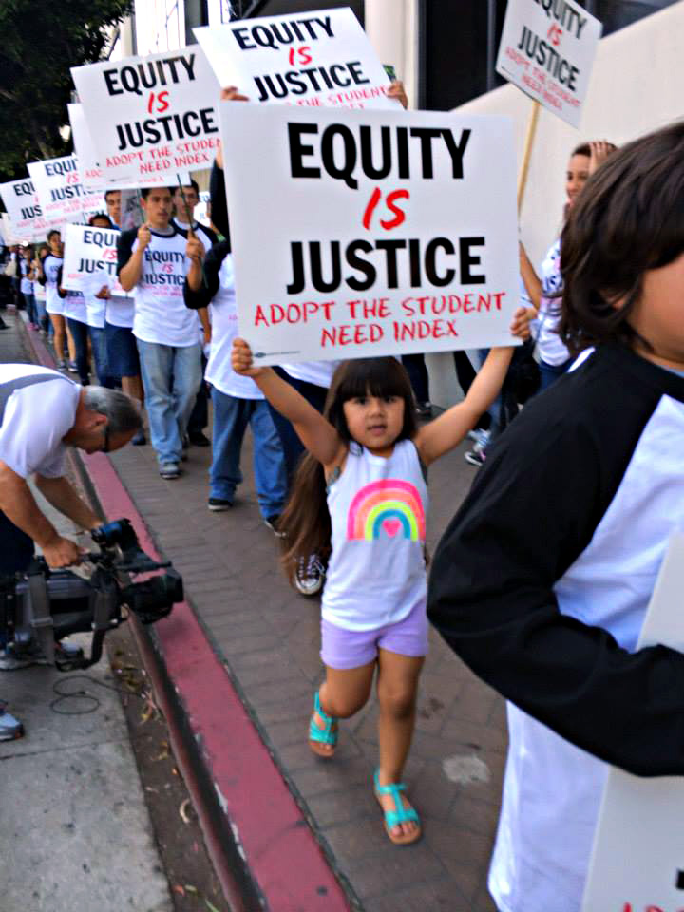

Slide 18
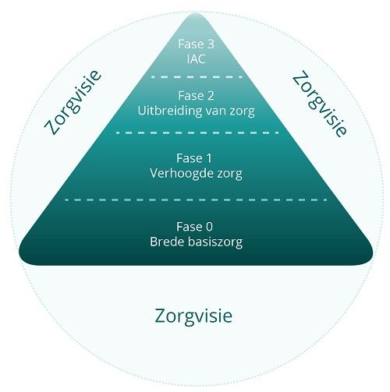
Our vision on care
Individually adapted curriculum
CLB, PBD, Ondersteuningsteams
Expansion of care
Increased care
School, CLB, PBD
Wide basic care
Notes:
Center for student guidance

Slide 19
Inclusion
https://www.youtube.com/watch?v=X8CNuh1IC3o
Including Samuel
https://www.youtube.com/watch?time_continue=77&v=nzIybNq8_GU
Bert

Slide 20
ONDERSTEUNINGSNETWERK
Samenwerkingsverband 1
Scholengroepen
CLB
PBD
Samenwerkingsverband 2
OT X
OT Y
Ondersteunings-team A
OT B
OT Z
OT C

Slide 21



