Slide 1

Equity in the Catalan Educational System
Sub-direcció General de la Inspecció d’Educació

Slide 2
Equity Conditions and Evaluation.
Principles of the Catalan Educational System.
According to the Catalan Law of Education: (LEC-2009)
  Inclusion and social cohesion, Equal opportunities for all, and Equity are seen as factors of quality in education.
  Quality in education is defined as “students achieving key competences and excellence in a context of equity.
  Integration for all kind of socioeconomic groups

Slide 3
Equity Conditions and Evaluation.
Other principles are:
  School autonomy.
  Participation of community and parents
  SEN students are divided between public and government funded private schools inside the Catalan schooling system to reach a certain balance among schools.

Slide 4
Equity Conditions and Evaluation.
Evaluation of Schools
The Inspectorate evaluates schools (kindergarten, primary, lower and upper secondary schools and, VET schools.) through two tools: SIC (School Indicator System) and AVAC (Annual School Evaluation).
Key concepts concerning School Evaluation:
  to get better school outcomes (academic and social outcomes)
  to empower schools through self-reflection on school actions and planning,
  to ensure an equity system: avoiding drop-out, absenteism, and cohabitation and living together.

Slide 5
Equity Conditions and Evaluation.
Evaluation Tools
SIC: System of indicators: Annual and Evolution document
AVAC: Annual School Evaluation: Students’ Performance, Planning and execution of Year objectives and Equity Conditions (Absenteeism, Cohabitation & Inclusion)
School Documents (School Project, ….)

Slide 6
Equity Conditions and Evaluation.
School Evaluation: SIC (System of Indicators). Context (I/III)
The school: participation of families
  Index of families associated to the Association of parents of students
  Index of families that make economic contributions for extra-curricular activities
Significant diversity (of students in the different stages: Pri, Sec)
  Index of students with SEN (motor, physical, psychic and sensory)
  Index of students with specific educational needs (with a disadvantaged socio-economic situation)
  Index of students of newcomers to the educational system (less than 2 years)
Students’ Nationality (in stages)
  Index of students of foreign nationality

Slide 7
Equity Conditions and Evaluation.
School Evaluation: SIC (System of Indicators). Context (II/III)
Aid (for stages)
  Index of students that enjoy grants for the acquisition of textbooks and complementary educational material
Secondary: curricular diversification programmes
  Index of 3rd year students (14-15 years) who attend programmes of curricular diversification
  Index of 4th year students who attend curricular diversification programmes
Individual plans
  Index of students with individualized school plan
The school: Mobility
  Student mobility index (by stages)
  Mobility index for teaching staff

Slide 8
Equity Conditions and Evaluation.
School Evaluation: SIC (System of Indicators). Context (III/III)
Student Absenteeism (greater than 5%)
  Student absentee rate (in stages) exceeding 5% (per term)
Student Absenteeism (greater than 25%)
  Student absentee rate (in stages) exceeding 5% (per term)
Teacher Absences
  Index of teacher absences that do not generate substitution
The school: demand
  Demand for school enrolment in the 1st year of the schooling

Slide 9
Equity Conditions and Evaluation.
School Evaluation: SIC (System of Indicators).
  Results & Resources
Results: Index of dropping-out of studies (stages)
Resources:
  Human resources:
    ratio students / teachers
    ratio teachers / students
    student / group ratio
  Human resources: socioeducational support staff
  Human resources: specific staff to support SEN

Slide 10
Equity Conditions and Evaluation.
SIC: System of Indicators generates an annual and an evolution document.
Example: Annual document

Slide 11
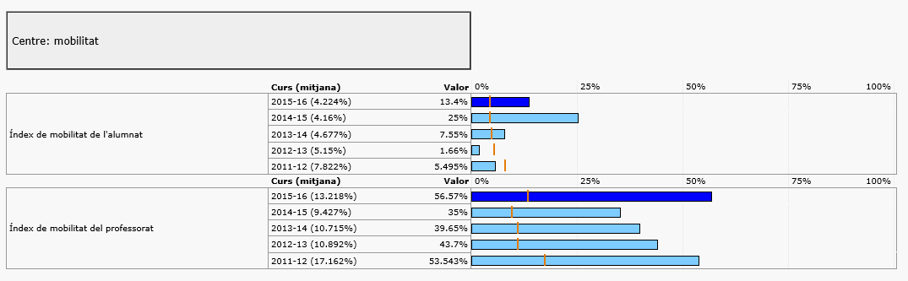
Equity Conditions and Evaluation.
SIC: System of Indicators generates an annual and an evolution document.
Example: evolution document

Slide 12
Equity Conditions and Evaluation.
Evaluation Tools
SIC: System of indicators: Annual and Evolution document
AVAC: Annual School Evaluation: Students’ Performance, Planning and execution of Year objectives and Equity Conditions (Absenteeism, Cohabitation & Inclusion)
School Documents (School Project, ….)

Slide 13
Equity Conditions and Evaluation.
Absentism and drop-out.
Cohabitation and líving together
Inclusion
Equity Conditions

Slide 14
Equity Conditions and Evaluation.
Rubric Equity Conditions:
Level | Absenteeism and Drop-out | Cohabitation and Living together | Inclusion
1 Elements: A | The school has mechanisms to detect and register students’ attendance | The School has rules for cohabitation and living together, but they are not applied systematically. The school uses not very effective information and communication mechanisms with School Community. | School resources are distributed homogeneously without considering students’ needs support.
2 Elements: A+B | A (includes previous item) + The school applies strategies for early detection and immediate intervention to guarantee assistance and prevent drop-out | A+ The school applies the school rules established before. The school uses information and communication mechanisms on a unidirectional way with school community. | A+ Distribution and management of resources are implemented according to the aids that SEN student need. The school has tools and procedures to detect the needs of SEN students and newcomers. Students with special needs and newcomers are identified and aid is given from time to time and guidance for learning process is not systematic.
3 Elements: A+B+C | A+B + The school analyses the causes and does prevention | A+B+ The school agrees its rules on a participative way and guarantees its adequate application. The school applies mechanisms and strategies in order to promote school community communication and participation. The school applies different strategies to promote for cohabitation and living together: school organization, tutoring and teacher coordination). | A+B+ School distribution resources are done considering needed aid for all students. The school has tools and procedures to detect all students’ needs. Teachers and external support is coordinated to offer efficient response to students with special needs. The school guarantees effective presence, participation and learning for all students.
4 Elements: A+B+C+D | A+B+C + The school applies strategies to welcome and protect students. School actions are periodically evaluated on the effectiveness and relevance of the actions | A+B+C+ The school evaluates periodically the effectiveness and relevance of their strategies. | A+B+C+ The school guarantees effective presence, participation and learning for all students and promote actions for sensitiveness with families and community. Periodically effectiveness and relevance of their strategies are evaluated.

Slide 15
Equity Conditions and Evaluation.
AVAC Tool (Annual School Evaluation)
Cohabitation and living together
  Cohabitation and living together must be based on communication, mutual respect, dialogue and participation in order to create a suitable climate to enable learning
Elements for evaluation
Elements of analysis for improvement proposals

Slide 16
Equity Conditions and Evaluation.
AVAC: Annual School Evaluation
Inclusion
  Inclusion (cohabitation and living together recognizes and values the difference as a collective enrichment factor) is understood as an endless process that seeks more effective ways to respond to students’ diversity.
Elements for evaluation
Elements of analysis for improvement proposals

Slide 17

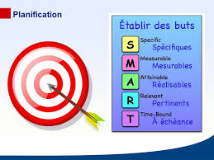


Equity Conditions and Evaluation.

Slide 18
Sub-direcció General de la Inspecció d’Educació
Equity in the Catalan Educational System
Thank you very much!

