Slide 1
Equity in Romanian Education
1. Defining the key concepts
2. Planning: Equity in the Romanian Law of Education
3. Implementing and assessing Educational Equity in Romania

Slide 2
1. Defining the key concepts:
Equity; Equity in education
Equity:
The quality of being fair and impartial. (Oxford
Dictionary)
A system of justice that allows a fair judgment of a case when the laws that already exist are not satisfactory. (Cambridge Dictionary)
Equity in education- educational opportunities for children ought to be equal.
Notes:
https://en.oxforddictionaries.com/definition/equity; https://dictionary.cambridge.org/dictionary/english/equity, accessed 12. 11.2017

Slide 3
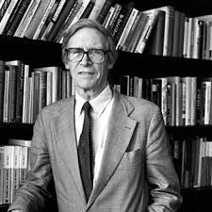
Defining the key concept
“Fair Equality of Opportunity”
The concept “requires that social offices and positions be formally open to all, and that individuals who are similarly talented and motivated should have a roughly equal chance to attain these positions, independent of their social class background”. (J. Rawls)
Notes:
Liam Shields, Anne Newman, Debra Satzs, Equality of Educational Opportunities, (31 May 2017), in https://plato.stanford.edu/entries/equal-ed-opportunity/#Bib., accessed 12.11.2017.
J. Rawls, 2001, Justice as Fairness: a Restatement, Cambridge, MA: Harvard University Press.

Slide 4
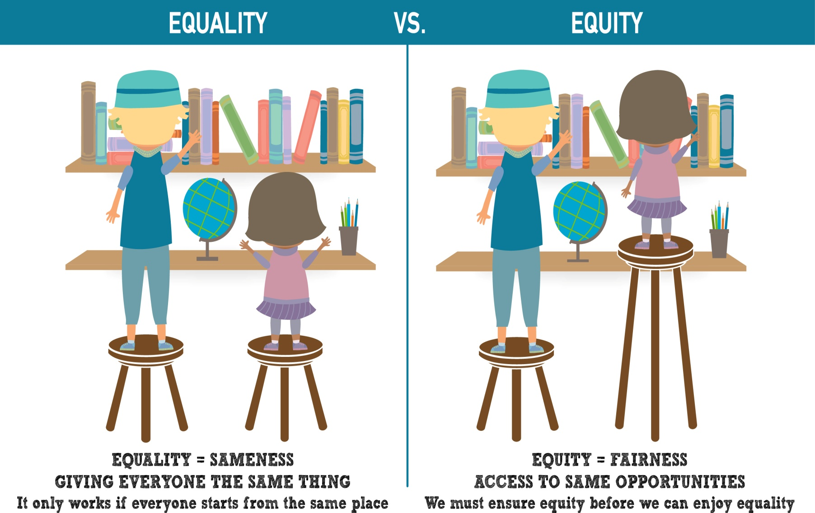
Defining the key concept
“Fair Equality of Opportunity”
Notes:
https://www.getsmartoregon.org/about-smart/equity/

Slide 5
1. Defining the key concepts
“Fair Equality of Opportunity”
Key concepts:
welfare of the least advantaged,
race, gender,
anti-discrimination principle,
education for the labor market
(skills acquired during formal studies,
citizenship),
educational resources.

Slide 6
2. Planning :
Equity in the Romanian Law of Education
Art2: The Romanian educational Ideal consists of free development of human individuality, development of an autonomous personality, achievement of a system of values necessary for anterprenorial behavior, active citizenship, social incluzion and employment on the market labor.
The State ensures that its citizens have equal rights to study. These rights include all the educational levels, as well as lifelong learning, without discrimination.
Notes:
The Romanian Law of National Education, 1/2011, from https://lege5.ro/Gratuit/geztsobvgi/legea-educatiei-nationale-nr-1-2011/7, accessed 12.11.2017.

Slide 7
2. Planning :
Equity in the Romanian Law of Education
Art 3: The basic principles for the Romanian education and for lifelong learning are:
The principle of equity- provides access to learning without discrimination;
Other principles: quality, relevance, efficiency, public respnsibility, assuring the national minorities’ right to education, special education, equal opportunies, etc.

Slide 8
2. Planning :
Equity in the Romanian Law of Education
Art 30: The School Inspectorates can organize the ”Second Chance” educational programs for people who exceed with 4 years the class age and have not completed the inferior secondary education.

Slide 9
3.Implementing and Assessing Educational Equity in Romania
The National Education Law , art. 94, 3:
In fulfilling its atributions, the Ministry of Education establishes, organizes and finances national committees and councils.
Institutions:
The County School Inspectorates;
The National Council of Ethics;
County Ethics Commitees (organized at the level of County School Inspectorates).
Tasks:
to elaborate the Code of Ethics in pre-university education;
to apply the Teacher`s Ethical Code;
to dissemninate ethical rules;
to assess, analyze, solve the complaints based on Teacher`s Ethical Code.
Notes:
Regulation on organizing and functioning the National Ethics Council in pre-university education, 6.10.20111, from https://lege5.ro/Gratuit/gi3denbvgm/regulamentul-de-organizare-si-functionare-a-consiliului-national-de-etica-din-invatamantul-preuniversitar-din-06102011?d=2017-11-15, accessed 12.11.2017.

Slide 10
Implementing and Assessing Educational Equity (The Theacher`s Ethical Code)
Values,
Principles
professional liberty,
Rules of behavior with:
pupils: protection of students` health, eliminating any activity that generates corruption
Manager
behavior
Mutual trust
Responsibilities
Any person involved in education has the right to refer an unethical matter to the Ethics Commitee.
moral and professional responsibility,
confidence,
honesty,
intelectual rightness,
parents,
colleagues
Communication,
Confidence,
Promoting professional and moral standards.
Notes:
The Ethical Code for Pre-university Education, from https://www.edu.ro/sites/default/files/proiect%20cod%20etica%2019_12_2016.pdf

Slide 11


Slide 12
References
Shields, Liam, Newman, Anne, Satzs, Debra, Equality of Educational Opportunities, (31 May 2017), in https://plato.stanford.edu/entries/equal-ed-opportunity/#Bib., accessed 12.11.2017.
Rawls, J., 2001, Justice as Fairness: a Restatement, Cambridge, MA: Harvard University Press.
Regulation on organizing and functioning the National Ethics Council in pre-university education, 6.10.20111, from https://lege5.ro/Gratuit/gi3denbvgm/regulamentul-de-organizare-si-functionare-a-consiliului-national-de-etica-din-invatamantul-preuniversitar-din-06102011?d=2017-11-15, accessed 12.11.2017.
The Romanian Law of National Education, 1/2011, from https://lege5.ro/Gratuit/geztsobvgi/legea-educatiei-nationale-nr-1-2011/7, accessed 12.11.2017.
https://www.getsmartoregon.org/about-smart/equity/

