Slide 1
Sarah Stewart
(United Kingdom – Wales)

Slide 2
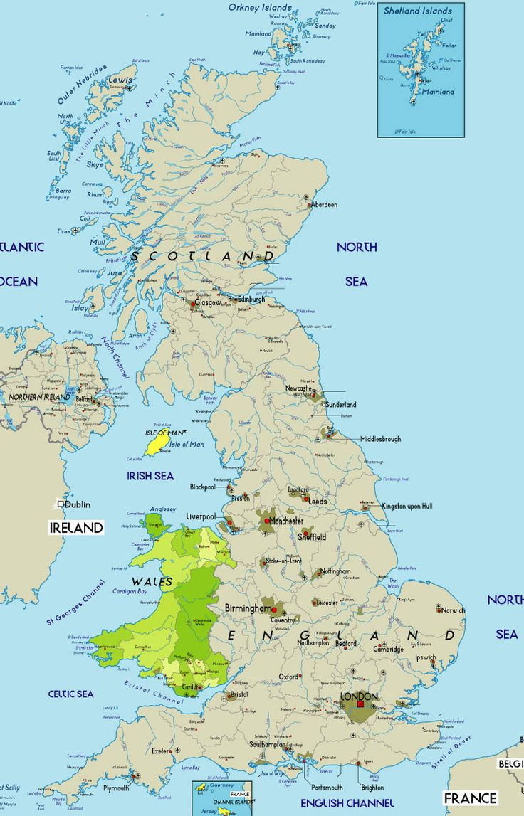

Notes:
Wales is a small country that is part of the United Kingdom (UK) and the island of Great Britain.
Bordered by England to its east and the Atlantic Ocean and Irish Sea to its west, the country has about
3.1 million inhabitants, which is 5% of the total UK population (Office for National Statistics, 2012).
Wales has a form of self-government similar to the Scottish Parliament and the Northern Ireland
Assembly
The Welsh school system is relatively small. In 2013, there were 464 868 students in 20 nurseries, 1 374 primary schools, 4 middle schools (which include both primary and secondary education), 216 comprehensive secondary schools and 42 special schools. There were 68 private (independent) schools, 2 more than in January 2012. Overall, there were 42 fewer local authority public schools2 than in January 2012. Since 2012, there has been a 0.2% decrease in the student population in part due to the smaller number of 11-15 year-olds (Welsh Government, 2013c). Education is compulsory for 5-16 year-olds but many children begin their education at the age of 4 and continue beyond the age of 16. They follow a similar curriculum until age 16. The period of compulsory education is divided into four stages: the Foundation Phase (ages 3-7) which combines early years education with the first two years of compulsory education (which were formerly known as Key Stage 1), Key Stage 2 (ages 7-11), Key Stage 3 (ages 11-14) and Key Stage 4 (ages 14-16). At age 16, the majority of pupils continue their studies either at their secondary school, if they have a sixth form (for 16- 18/19 year-olds), or at a further education institution (Eurypedia, 2013). Vocational education is available for students in post-compulsory education, and students may take a combination of academic and vocational courses (see Table 1.1).
Since the “Devolution settlement” in 1999, which devolved powers on education and training, Wales, like Scotland and Northern Ireland, has had responsibility for nearly all areas of education policy, except for teachers’ salaries. Wales has pursued distinct education policies that have resulted in a gradual differentiation from those of England, aiming to match its education needs.

Slide 3
Structure of Curriculum
National Curriculum
Foundation Phase (includes KS1)
Key Stage 2
Key Stage 3
Key Stage 4
3-7
7-11
11-14
14-16
Areas of Learning
Programme of Study
Syllabus
Outcomes
Levels
Grades
Notes:
NEETS
Young people may leave education and training at age 16 in Scotland, Wales and Northern Ireland. The compulsory participation age in education and training is being raised to 17 from 2013 and 18 years of age from 2015 in England. 16-18 year olds are guaranteed a place in education or training in England which also extends to 19 year olds in Scotland and Wales, should they wish to attend. In Northern Ireland, all unemployed 16-17 year old school leavers are offered a guarantee of a training place
There were 790,000 young people (aged 16 to 24) in the UK who were not in education, employment or training (NEET), a decrease of 10,000 from January to March 2017 and down 56,000 when compared with April to June 2016.
The percentage of all young people in the UK who were NEET was 11.1%, down 0.1 percentage points from January to March 2017 and down 0.6 percentage points from April to June 2016.
41.1% of all young people in the UK who were NEET were looking for work and available for work and therefore classified as unemployed; the remainder were either not looking for work and/or not available for work and therefore classified as economically inactive.

Slide 4
Poverty
Across the UK, around 3.9 million people live in persistent poverty
(Office for National Statistics, 2016 cited in Joseph Rowntree Foundation, 2016).
Levels of poverty across the UK will rise by 2020.
25% of children will be living in child poverty.
This will result in a failure to meet the 10% target which was set out in the 2010 Child Poverty Act
(Joseph Rowntree Foundation, 2016).
Notes:
This is unsurprising given the scale of the problem of poverty in the UK and this is particularly problematic for Wales, too, which is generally considered the poorer nation.

Slide 5
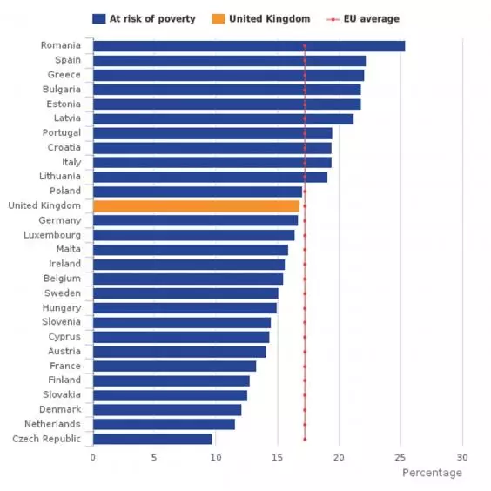

Slide 6
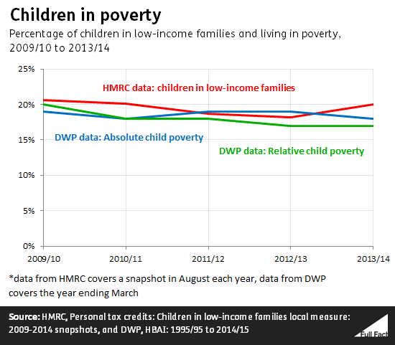

Slide 7
Poverty in Wales
Household income in Wales is 15% below the British average.
Almost a quarter of the Welsh population live in relative poverty, (which is defined as income below sixty percent of the median average).
Measures of absolute poverty are similar - around twenty two per cent.
(Joseph Rowntree Foundation, 2016)
Notes:
In terms of childhood poverty, almost as many as one in three children in Wales will live in poverty (Save the Children, 2017) and according to a recent report by the Institute of Fiscal Studies (2017), Wales is set to be particularly hard hit by recent cuts to child tax credits and a move to universal credit.

Slide 8
One in three children in Wales have a special educational need (OECD, 2014) (at a time where our SEN system is ‘no longer fit for purpose’ (OECD, 2017).
Just over eight percent of our learners are from minority ethnic backgrounds, including five hundred children in Wales from a Roma Gypsy and traveller background.
Since 2012, there has been a twenty four percent increase in children who are looked after (OECD, 2017).
Notes:
Many of our learners’ attainment in Wales is affected not only by poverty, but by a host of other issues, too. For example, the OECD (2014) recognises that the current system for supporting learners with additional learning needs (ALN) is no longer fit for purpose. It is true that one in three of our children live in poverty, but one in three also have a special educational need (OECD, 2014).
Research shows that poverty has an impact, but it also demonstrates that ALNs, gender, class and ethnicity can also have an effect on the attainment of a learner (Bartlett and Burton, 2016).

Slide 9

Poverty and Attainment
“There is a strong statistical link between poverty and low educational attainment. In general, pupils from poorer families are still far more likely to attain at lower levels than other pupils.”
(Estyn, 2010)
Source: End Child Poverty
Notes:
For some time now, ‘equity’ has been the code-word for ‘poverty’ and the effects that socio-economic background has on a child’s educational journey.

Slide 10
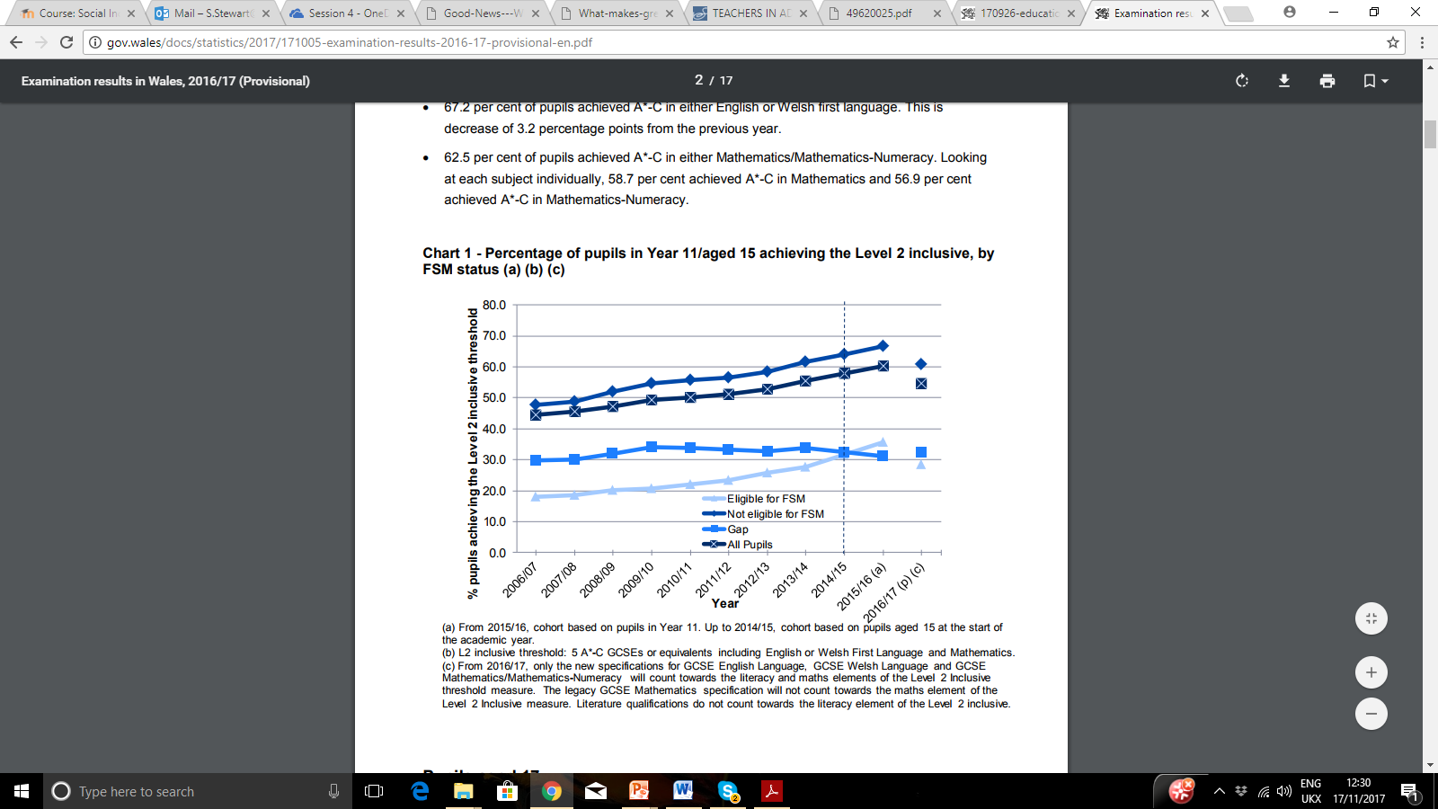
Welsh Government, 2017b
Notes:
Whilst the gap has indeed closed, it has come at the expense of those at the highest attaining end, which has also dropped and whilst we can see a four percentage point closing of the gap, which is indeed an improvement on the previous year’s 31.6 percent, we are still talking about a human cost of approximately eleven thousand four hundred and eighty children left behind their wealthier peers (Welsh Government, 2017a; Welsh Government, 2017b).

Slide 11

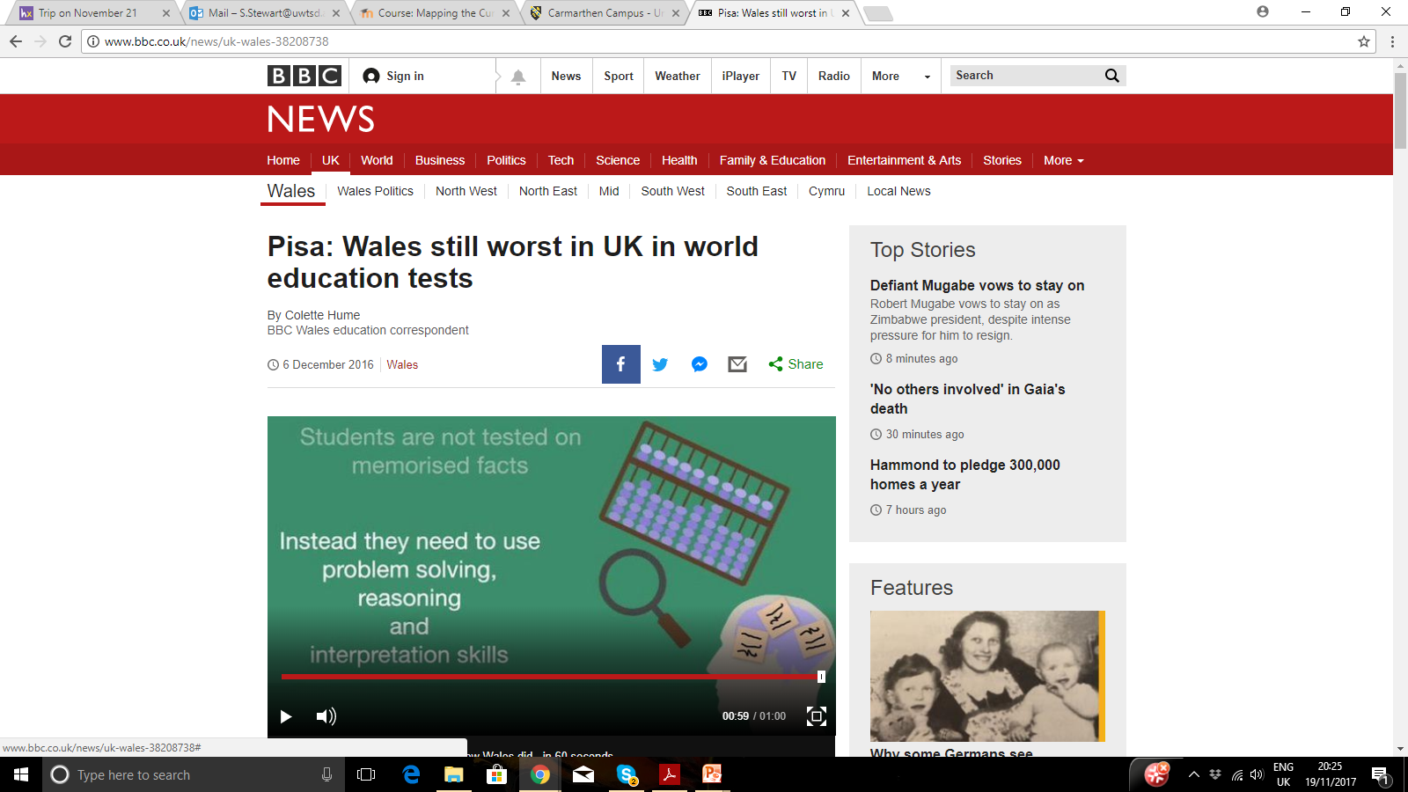

PISA Results (2016)

Slide 12
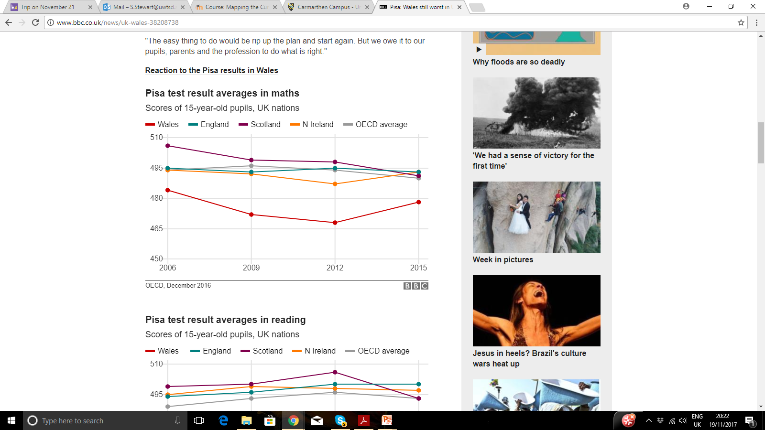
BBC, 2016

Slide 13
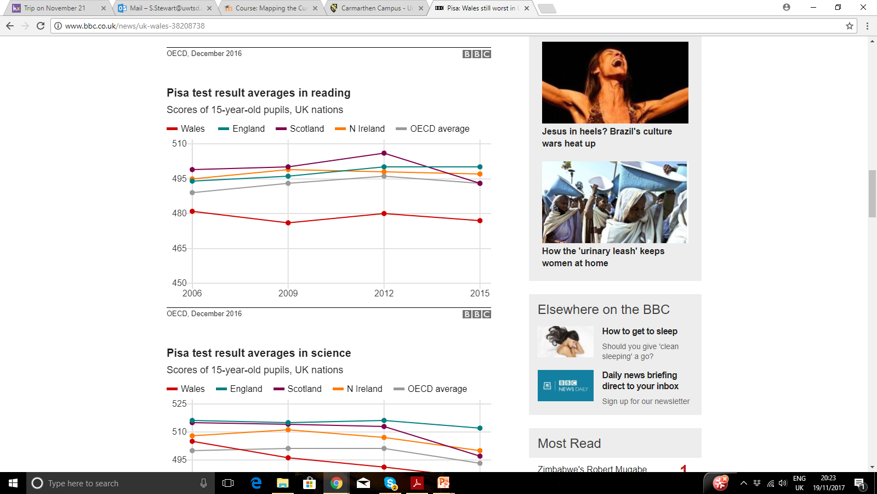
BBC, 2016

Slide 14
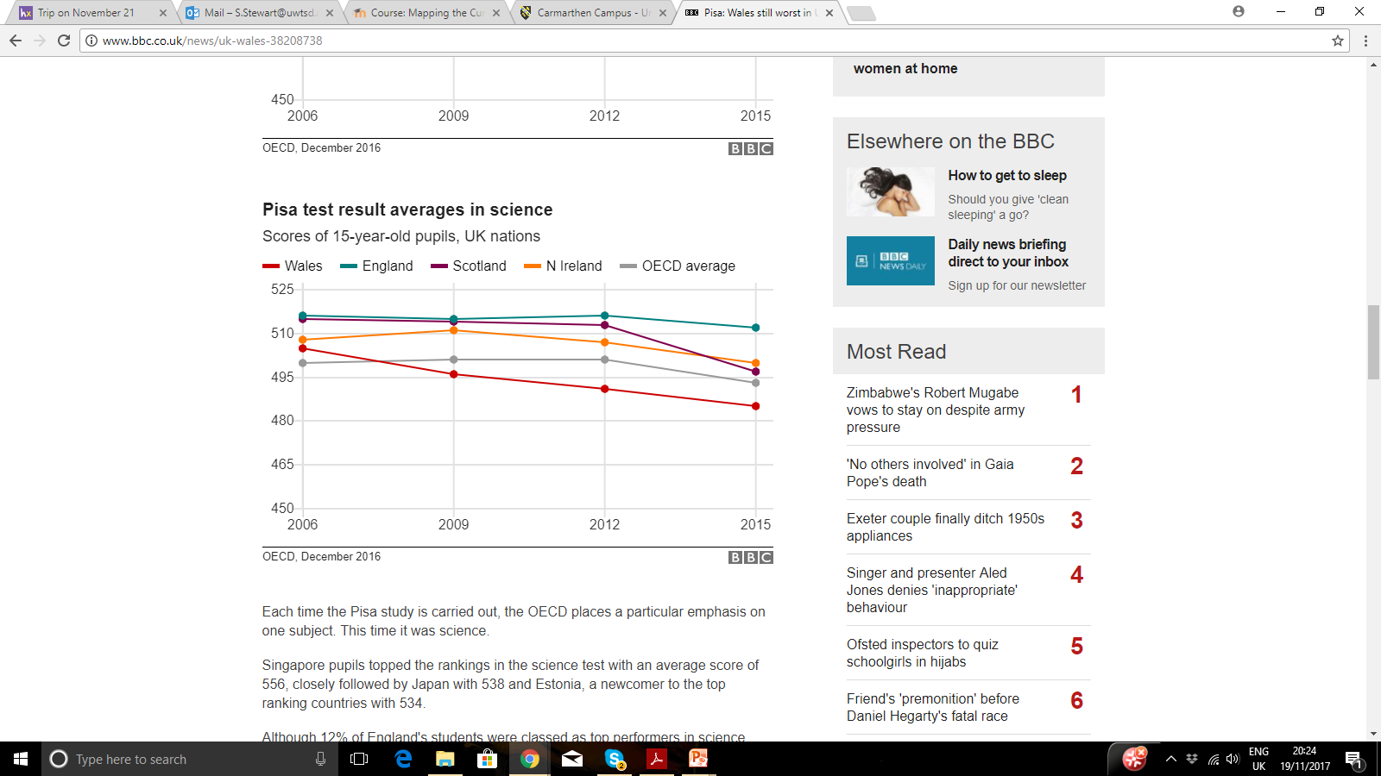
BBC, 2016

Slide 15
A Context of Educational Reform
Divergent paths
  England – Academies, free schools, grammar schools
  Wales – retained a ‘comprehensive’ education system (for the most part)

Slide 16
Tackling Poverty Initiatives
(A Sample…)
Communities First
Flying Start
RAISE
Schools Challenge Cymru
Pupil Deprivation Grant
Grigg et al, 2014
Notes:
In other spheres, Welsh Government has been quick to point out the opposite – that significant levels of investment have indeed been made in tackling the effects of poverty in Wales, particularly within the context of education, even issuing a written statement (Welsh Government, 2012). A three pronged attack on poverty involving the prevention of poverty, helping people into work and mitigating the impact of poverty saw a central role for schools, with a key focus being placed on improving educational attainment for all, regardless of socio-economic background (Clapham, 2014). In the period of reform triggered by low PISA rankings in 2011 (OECD, 2014) we have seen rafts of poverty initiatives in Wales (Grigg et al, 2014). So, is it fair to ask the question now, are we nearly there yet?
Pupil deprivation grant renamed development grant. Also EY version introduced. 1150 and 600 respectively. Commitment made by cab sec to end of term to provide security. In England there is a similar grant called pupil premium. 1320 in primary and 935 in secondary last year. Some children may get 1900 e.g lac.
Cf estimated 300 million spend (65% on admin and staff costs) since 2001. Claims that regional rather than targeted initiatives more effective. Covered around 20% of population and targeted communities.
Flying start – 0-3. Childcare, parenting support, health visitor, early literacy.
Raise - 648 of schools with most poverty. Team around the family – raise grant if over 20% efsm.
Scs – 40 schools in clusters.

Slide 17
Tackling Poverty
Develop a whole-school strategic approach.
Tracking progress using data.
Improving disadvantaged learners’ literacy.
Focus on social and emotional skills.
Tailor the curriculum to meet the needs of disadvantaged pupils.
Improve and track attendance.
Enriched curriculums and extra-curricular experiences.
Engaging with parents.
Listening to learners.
Developing expertise of staff to meet the needs of disadvantaged pupils.
Estyn, 2012
Notes:
The reality is, that we are still quite far from reaching our destination, the arrival of which is described most recently as a system which recognises that ‘equity and excellence go hand in hand and [where] we cannot have one at the expense of the other’ (Welsh Government, 2017a, p.2). Previously Estyn (2012) identified a number of concrete ways schools can tackle poverty which emphasised that schools need to take a strategic approach to tackling poverty, make excellent use of data about both progress and attendance and to improve disadvantaged pupils’ social, emotional, literacy and numeracy skills through providing an enriched and tailored curriculum to meet learners’ needs.

Slide 18
Rewriting the Future
Reducing the impact of poverty on education
High quality learning and teaching
Early years
Family and community engagement
High expectations and aspirations
Families and communities provide the context for learning for children.
(Welsh Government, 2015)
High quality teaching and learning is the most effective way of closing the gap within a school context.
(Welsh Government, 2014).
Notes:
These concepts were developed further in Re-Writing the Future (Welsh Government, 2014) which identified four areas of focus needed to reduce the impact of poverty. These areas reflected two significant and powerful levers that we have about disadvantage in the classroom – that families and communities provide the context for learning for children (Welsh Government, 2015) and that high quality teaching and learning is the most effective way of closing the gap within a school context (Welsh Government, 2014). Children who experience disadvantage are ‘more likely to experience poorer quality of teaching’ (Hill, 2013 in Egan et al, 2014) or have less experienced teachers (Sutton Trust, 2016) yet, we know that highly effective teachers will support disadvantaged learners to make the most progress.

Slide 19
Coe et al (2014): Strong Evidence of Impact on Student Outcomes: (Pedagogical) content knowledge Quality of instruction | Higgins et al (2014): Highest impact: + 8 months Feedback Metacognition and self regulation
Hattie (2012): Expert teachers : Identify the most important ways to represent the subjects they teach Monitor learning and provide feedback Create an optimal classroom climate for learning Influence surface and deep student outcomes. | Estyn (2012): Tailor the curriculum to meet the needs of disadvantaged pupils. Develop expertise of staff to meet the needs of disadvantaged pupils.
Differentiated teaching which meets student need
Effective use of formative assessment approaches
OECD, 2017
Notes:
This is a finding that is repeated across the research and common themes include the highly-skilled ability of the educator to adapt teaching effectively to meet individual learner needs and effective use of assessment, underpinned by an ‘assessment for learning’ approach (Estyn, 2012; Hattie, 2012; Coe et al, 2014; Higgins et al, 2014).

Slide 20

The Challenge
Notes:
We know what works, however, putting it into practice is somewhat more of a challenge for Wales. In its 2014 review of Wales’ education system, the OECD (2014) noted that differentiated teaching and use of formative assessment were the two most underdeveloped aspects which posed a risk, with Estyn (2014, cited in OECD, 2014) identifying as many as 40% of schools needing significant improvements in this area. In a recent update review, the use of formative assessment as a means by which a teacher can respond to students’ individual needs, remains insufficient, despite an enthusiastic pace of reform (OECD, 2017).

Slide 21

“Strong and inclusive schools, committed to excellence, equity and wellbeing”
(Welsh Government, 2017a, p. 23).
Notes:
So, how do we go forward? Our National Mission reinforces Wales’ commitment to equity, with explicit reference to the concept in one of its four enabling objectives: “Strong and inclusive schools, committed to excellence, equity and wellbeing” (Welsh Government, 2017a, p. 23). However, this document also marks a subtle shift in the discourse surrounding equity. There is far less explicit focus on deprivation (a word which is used only once and with no mention of poverty at all).
On the one hand, this could be viewed as a possible danger which Rassool (2000) argues is inherent in a school effectiveness approach which focuses on organisational factors, rather than tackling poverty, deprivation and social exclusion on its own terms. This is echoed by Fulcher (1989 cited in UNESCO, 2017) who reminds us that inclusion and equity cannot be considered as a technical change alone, but that a clear philosophical direction is required. It is worth reflecting on Fulcher’s words as he links equity closely with inclusion, echoing the OECD (2008; 2014) definitions of equity with which this presentation began. The shift in language here in fact demarks not a neglect to consider deprivation but rather a wider, philosophical understanding of the term equity – which despite the narrative over the last few years, is NOT synonymous with only poverty, at all.

Slide 22
Our National Mission
“Equity requires that we ensure that the system, at school, local and national level takes account of and responds to the unique challenges that presents themselves to individuals or groups of learners.” (Welsh Government, 2017a, p. 30)
“We are determined that no challenge should prevent any learner from reaching their potential, including those learners who experience several ACEs.” (Welsh Government, 2017a, p. 31)
Notes:
Our National Mission (Welsh Government, 2017a) sets out a broadening understanding of equity, a key proponent of developing the strong philosophical understanding needed to progress. However, it is not all bad news –learners’ performance is less dependent on socio-economic background than in other countries (OECD, 2014). So, we must begin to view equity in its broadest sense….

Slide 23
So, what is happening now?
Initiatives have been streamlined (but funding needs to be more stable)
New curriculum (and new model of teacher training and professional learning)
New ALN Bill
Review of the inspectorate ‘Estyn’

Slide 24
What still needs to happen?
Develop coherence across initiatives
  Needs based funding
  All stakeholders to understand roles
  Investment in ‘professional capital’ at all levels
Strengthen school improvement infrastructure
Avoid ‘reform fatigue’

Slide 25
Over Arching Challenge
“Wales lacks a compelling and inclusive long-term education vision to steer the education system and its reform efforts.” (OECD, 2014, p.11)
Wales still needs to focus on ‘supporting the realisation of the national commitment to equity’ (OECD, 2017, p3).
Notes:
…particularly if we are to meet what the OECD (2014) notes is Wales’ overarching challenge to develop a clear, consistent vision for the journey ahead, in which further practical steps are needed to ‘fully realise the national commitment to equity’ (OECD, 2017, p3).

Slide 26
Reference List
Bartlett, S. and Burton, D. (2016) Introduction to Education Studies, (4th ed.) London: Sage.
BBC (2016) ‘No end to child poverty by 2020’, BBC News, 13 December [Online]. Available at: http://www.bbc.co.uk/news/uk-wales-politics-38308763 (Accessed: 17 November 2017).
Booth, T. and Ainscow, M. (2002) Index for Inclusion: Developing learning and participation in schools. Centre for Inclusive Studies. [Online]. Available at: http://www.eenet.org.uk/resources/docs/Index%20English.pdf (Accessed: 17 November 2017).
Clapham, D. (2014) Regeneration and Poverty in Wales. York: Joseph Rowntree Foundation/Sheffield Hallam University. [Online]. Available at: https://www4.shu.ac.uk/research/cresr/sites/shu.ac.uk/files/jrf-regeneration-poverty-wales.pdf (Accessed: 17 November 2017).
Coe, R., Aloisi, C., Higgins, S., Elliot Major, L. (2014) What Makes Great Teaching? Review of the Underpinning Research. Durham: Centre for Evaluation and Monitoring/ Sutton Trust. [Online]. Available at: https://www.suttontrust.com/wp-content/uploads/2014/10/What-makes-great-teaching-FINAL-4.11.14-1.pdf (Accessed: 17 November 2017).

Slide 27
Egan, D., Saunders. D., & Swaffield, L. (2014) Making Effective Use of the Pupil Deprivation Grant. Cardiff: Wales Centre for Equity in Education. [Online]. Available at: http://www.uwtsd.ac.uk/media/uwtsd-website/content-assets/documents/equity-in-education/making_effective_use_of_PDG.pdf (Accessed: 17 November 2017).
Estyn (2010) Tackling Child Poverty and Disadvantage in Schools, Cardiff: Estyn.
Estyn (2012) Effective Practice in Tackling Poverty and Disadvantage in Schools. Cardiff: Estyn. Available at: https://www.estyn.gov.wales/sites/default/files/documents/Effective%20practice%20in%20tackling%20poverty%20and%20disadvantage%20in%20schools%20-%20November%202012.pdf (Accessed: 17 November 2017).
Grigg, R., Egan, D., McConnon, L., Swaffield, L. (2014) The Good News – what schools are doing in Wales to reduce the impact of poverty on attainment. Cardiff: Wales Centre for Equity in Education. Available at: http://www.uwtsd.ac.uk/media/uwtsd-website/content-assets/documents/wcee/Good-News---Whats-schools-in-wales-are-doing-to-reduce-the-impact-of-poverty-on-pupils-achievement---Wales-Centre-for-Equity-in-Education-December-2014.pdf (Accessed: 17 November 2017).
Hattie, J. (2012) Visible Learning for Teachers. Oxon: Routledge.

Slide 28
Higgins, S., Katsipataki, M., Kokotsaki, D., Coleman, R., Major, L.E., & Coe, R. (2014) The Sutton Trust-Education Endowment Foundation Teaching and Learning Toolkit. London: Education Endowment Foundation. [Online]. Available at: https://www.suttontrust.com/about-us/education-endowment-foundation/teaching-learning-toolkit/ (Accessed: 17 November 2017).
Hood, A. & Waters, T. (2017) ‘Living standards, poverty and inequality in the UK: 2017–18 to 2021–22’, A Report for the Institute of Fiscal Studies. [Online]. Available: https://www.ifs.org.uk/uploads/publications/comms/R136.pdf. (Accessed: 17 November 2017).
Joseph Rowntree Foundation (2016) Prosperity without Poverty. York: Joseph Rowntree Foundation. [Online]. Available at: https://www.jrf.org.uk/report/prosperity-without-poverty (Accessed: 17 November 2017).

Slide 29
Organisation for Economic Co-operation and Development (2008) Ten Steps to Equity in Education: Policy Brief. [Online]. Available at: http://www.oecd.org/education/school/39989494.pdf (Accessed: 17 November 2017).
Organisation for Economic Co-operation and Development (2014) Improving Schools in Wales: an OECD Perspective. Paris: OECD. [Online]. Available at: http://www.oecd.org/edu/Improving-schools-in-Wales.pdf (Accessed: 17 November 2017).
Organisation for Economic Co-operation and Development (2017) The Welsh Education Reform Journey: A Rapid Policy Assessment. Paris: OECD. [Online]. Available at: http://www.oecd.org/edu/The-Welsh-Education-Reform-Journey-FINAL.pdf (Accessed: 17 November 2017).
The Sutton Trust (2016) Teachers in advantaged schools are more experienced than those in deprived schools. [Online]. Available at: https://www.suttontrust.com/newsarchive/teachers-in-advantaged-schools-are-more-experienced-than-those-in-deprived-schools/ (Accessed: 17 November 2017).
UNESCO (2017) A guide for ensuring inclusion and equity in education. France: UNESCO. [Online]. Available at: http://unesdoc.unesco.org/images/0024/002482/248254e.pdf (Accessed: 17 November 2017).

Slide 30
Welsh Government (2012) Written Statement: Tackling Poverty. [Online]. Available at: http://gov.wales/about/cabinet/cabinetstatements/previous-administration/2012/tacklingpoverty/?lang=en (Accessed: 17 November 2017).
Welsh Government (2014) Rewriting the Future. Cardiff: Welsh Government. [Online]. Available at: http://gov.wales/topics/educationandskills/schoolshome/deprivation/rewriting-the-future-schools/?lang=en (Accessed: 17 November 2017).
Welsh Government (2015) FaCE the Challenge Together: Family and community engagement toolkit for schools in Wales. Cardiff: Welsh Government. [Online]. Available at: http://learning.gov.wales/docs/learningwales/publications/160712-face-toolkit-main-en.pdf (Accessed: 17 November 2017).
Welsh Government (2017a) Education in Wales: Our National Mission. Cardiff: Welsh Government. [Online]. Available at: http://gov.wales/docs/dcells/publications/170926-education-in-wales-en.pdf (Accessed: 17 November 2017).
Welsh Government (2017b) Statistical First Release. [Online]. Available at: http://gov.wales/docs/statistics/2017/171005-examination-results-2016-17-provisional-en.pdf (Accessed: 17 November 2017).

